Slide 1
PRESENTATION ON Software development project
SUBMITTED TO :
DR. MD SHAFIUL ALAM
&
JISAN MAHMUD
SUBMITTED BY :
TANJILA BROTI
ID: 16-01-04-033
TAHMEED ASAAD RAHMAN
ID: 16-01-04-039
SAIFUL ISLAM
ID:16-01-04-040

Slide 2
overview
THE TYPE OF OUR PROJECT IS SHOOTING GAME
THE NAME OF THE GAME IS “ESCAPE THE HOUSE”
IN THIS GAME, THE PLAYER IS TRAPPED IN A HAUNTED HOUSE AND TO ESCAPE THE HOUSE HE HAS TO KILL ALL THE SCARY CREATURES PRESENT IN THE HOUSE

Slide 3
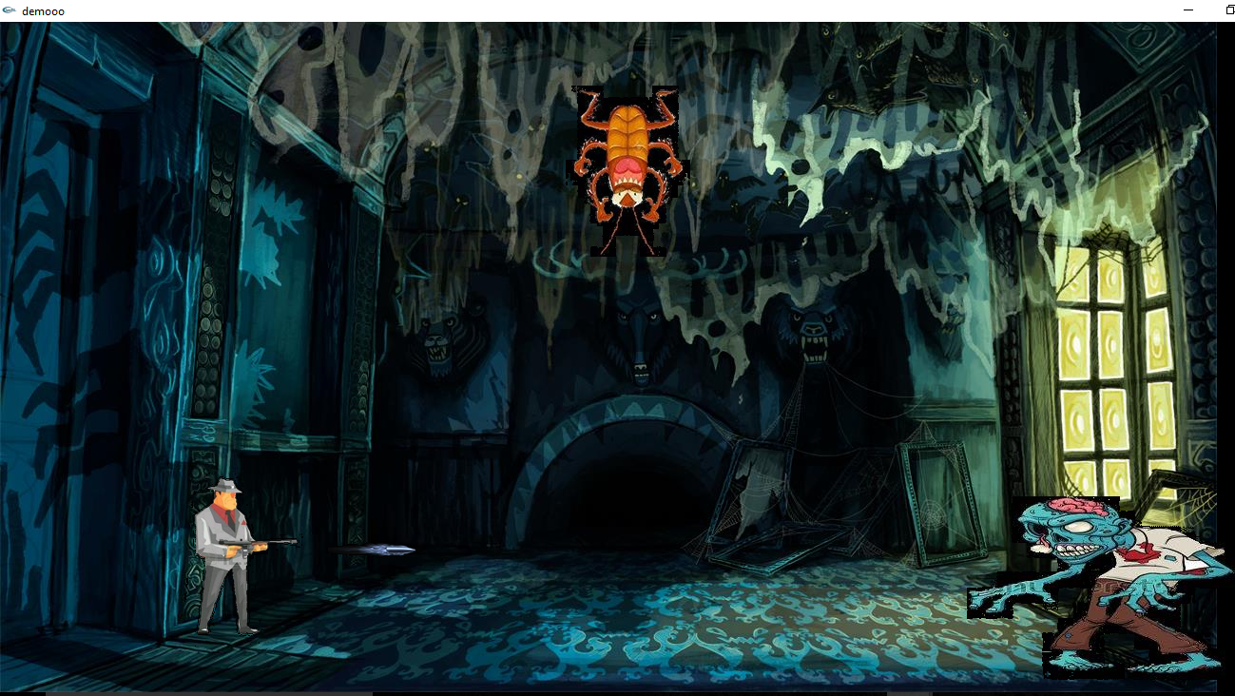
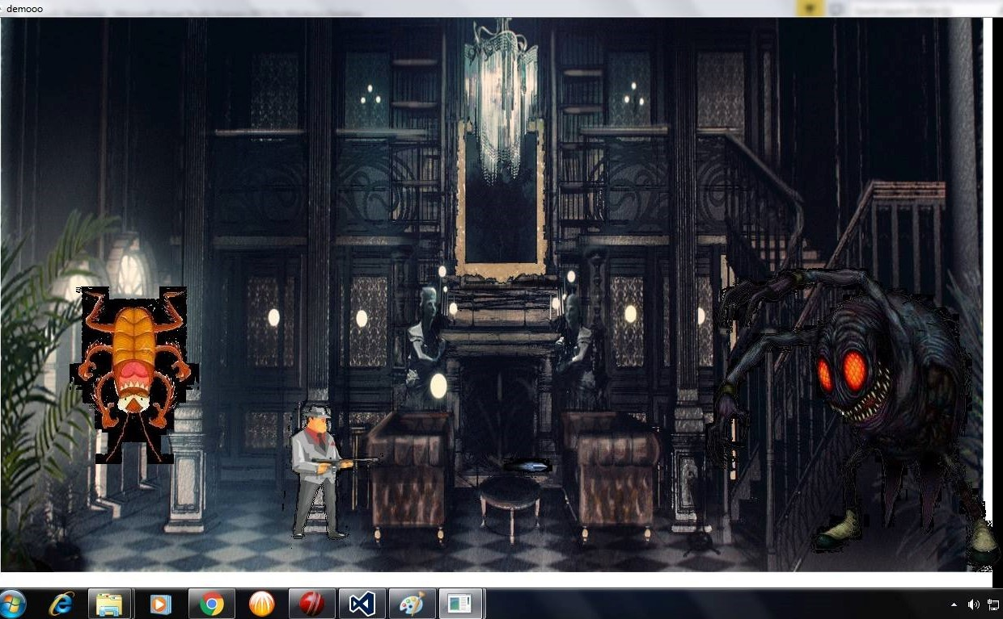

Slide 4

Features
THE CHARACTER CAN MOVE LEFT AND RIGHT
ZOMBIES AND OTHER SCARY CREATURES WILL CHARGE TOWARDS HIM
HE WILL HAVE A GUN AND HE CAN SHOOT TO KILL THEM

Slide 5
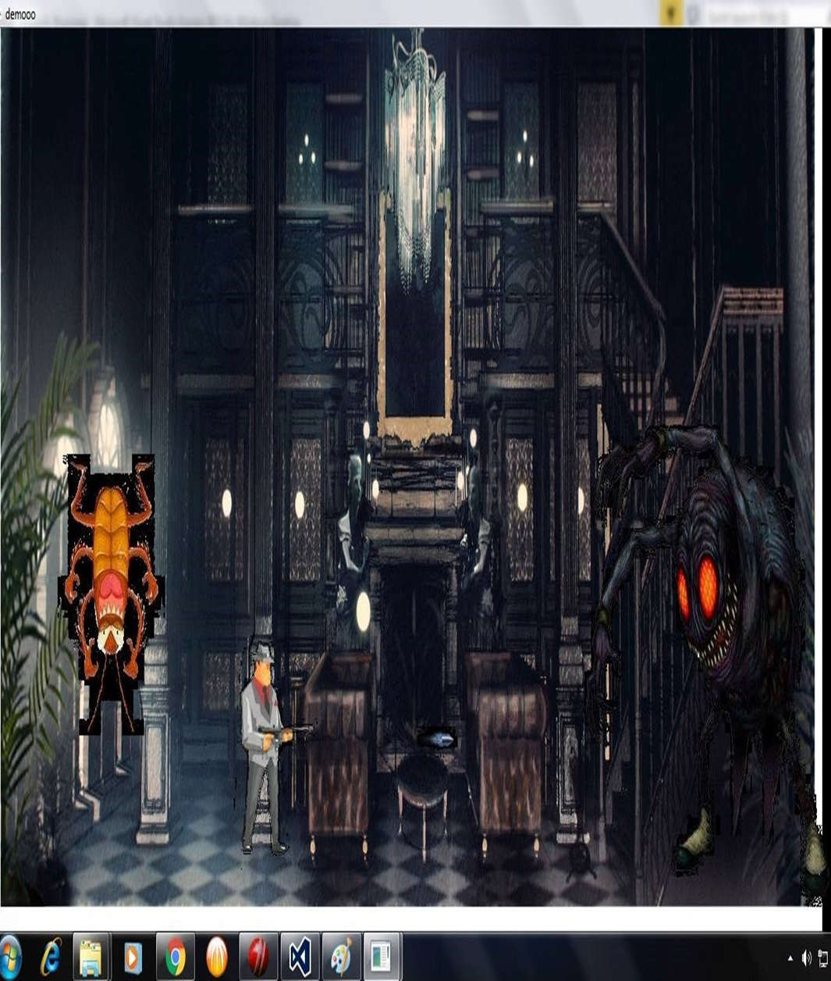
Features
SOME OTHER CREATURES WILL FALL FROM ABOVE
HE HAS TO DODGE THEM BY MOVING LEFT AND RIGHT
AFTER KILLING A CERTAIN NUMBER OF THE CREATURES, HE WILL MOVE TO THE NEXT LEVEL

Slide 6

Features
IF THE CREATURES HIT HIM, THE GAME WILL BE OVER
TO ESCAPE THE HOUSE, HE HAS TO PASS THE FINAL LEVEL WHERE HE WILL HAVE AN ENCOUNTER WITH THE MONSTER WHO CONTROLS THE HOUSE
THERE WILL BE AT LEAST 3 LEVELS IN THE GAME

Slide 7
FEATURE IMPLEMENTATION
THE CHARACTER CAN BE MOVED LEFT AND RIGHT BY INCREMENTING/DECREMENTING THE ABSCISSA OF THE IMAGES AND THE ZOMBIES WILL CHARGE TOWARDS HIM BY USING THE SAME METHOD WITH THE HELP OF THE “iDraw”, ”iShowBMP” AND THE “iSpecialKeyboard” FUNCTION AND WITH SOME “if-else” CONDITIONS.
THE “iKeyboard” FUNCTION AND SOME “if-else” CONDITIONS WILL BE USED FOR SHOOTING, THE BULLET WILL HIT THE ZOMBIE WHEN THE ABSCISSA OF THE BULLET WILL BE GREATER THAN/EQUAL TO THE ABSCISSA OF THE ZOMBIE.
THE CREATURES WILL FALL RANDOMLY FROM ABOVE BY USING “srand” FUNCTION, THE “srand” FUNCTION WILL RANDOMLY CHANGE THE ABSCISSA OF THE IMAGE OF THE CREATURES THAT ARE FALLING FROM THE ABOVE.
THE ZOMBIES WILL HIT THE PLAYER WHEN THE ABSCISSA OF THE ZOMBIE WILL BE LESS THAN OR EQUAL TO SUM OF THE ABSCISSA AND THE WIDTH OF THE CHARACTER.

Slide 8
WE WILL USE A VARIABLE TO KEEP COUNT OF THE NUMBER OF ZOMBIES THAT HAS BEEN KILLED, WHEN THE COUNT WILL REACH ITS LIMIT DEFINED BY US THEN THE PLAYER WILL MOVE TO NEXT LEVEL
THE CREATURES FALLING FROM THE ABOVE WILL HIT THE PLAYER WHEN THE ABSCISSA OF THE CREATUERS WILL BE GREATER THAN/EQUAL TO THE ABSCISSA OF THE PLAYER AND IT WILL BE LESS THAN/EQUAL TO THE SUM OF THE ABSCISSA AND THE WIDTH OF THE IMAGE OF THE PLAYER, SIMULTANEOUSLY THE ORDINATE OF THE CHARACTER WILL BE LESS THAN/EQUAL TO SUM OF THE ORDINATE AND THE HEIGHT OF THE PLAYER

Slide 9
Thank YOU EVERYONE

